Slide 1
Android 실습예제
Puzzle #1

Slide 2
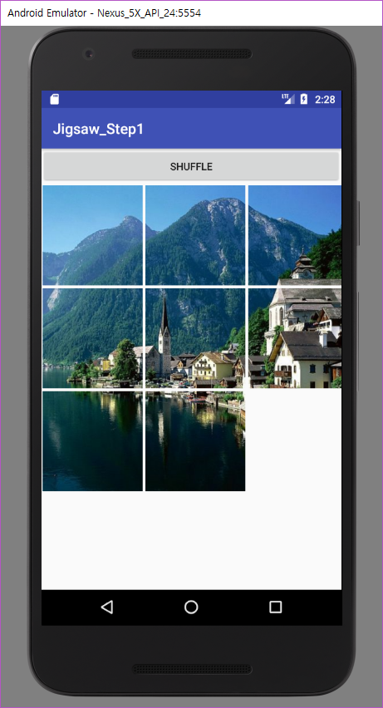
Layout
Button

Slide 3
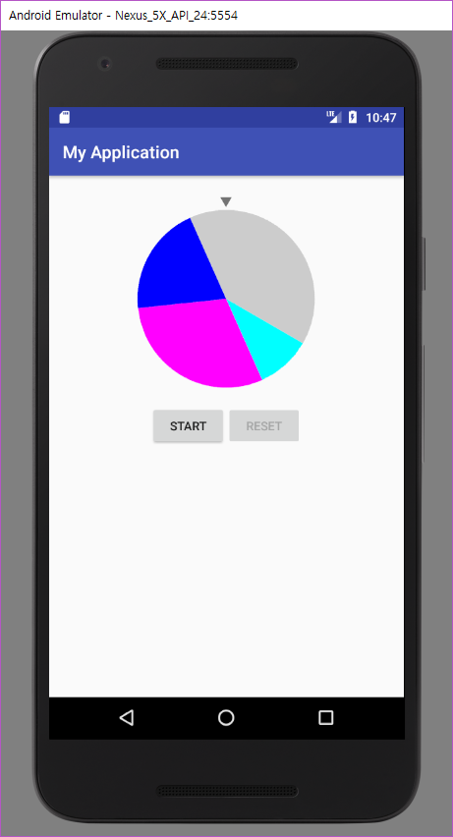
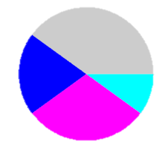
Roulette
MainView.java
@Override protected void onDraw(Canvas canvas){ super.onDraw(canvas); Paint paint = new Paint(); paint.setColor(Color.CYAN); canvas.drawArc(0,0,circleWidth, circleWidth, 0, 45, true, paint); paint.setColor(Color.MAGENTA); canvas.drawArc(0,0,circleWidth, circleWidth, 45, 90, true, paint); paint.setColor(Color.BLUE); canvas.drawArc(0,0,circleWidth, circleWidth, 135, 125, true, paint); paint.setColor(Color.LTGRAY); canvas.drawArc(0,0,circleWidth, circleWidth, 260, 100, true, paint); } | public class MainView extends View { int[] weight = {1,3,2,4}; String[] label = {"가","나","다","라"}; int[] colorList = { Color.CYAN, Color.MAGENTA, Color.BLUE, Color.LTGRAY }; int weightTot = 0; float unitAngle = 0; int lastangle = 0; ….. @Override protected void onDraw(Canvas canvas){ super.onDraw(canvas); for(int i=0;i<weight.length;i++){ weightTot += weight[i]; } unitAngle = 360/weightTot; Paint paint = new Paint(); for(int i=0;i<weight.length;i++){ paint.setColor(colorList[i]); float angle = unitAngle * weight[i]; canvas.drawArc(0,0,circleWidth, circleWidth, lastangle, angle, true, paint); lastangle += angle; } }
label
가
나
다
라
weight
1
3
2
4
+
+
+
=
weightTot
=
10
108
72
36
144
unitAngle = 360/10 = 36
360
216
144
가 : 0, 36
나 : 36, 108
다 : 144, 72
라 : 216, 144
72
0
36
108
36
144
drawArc(0,0,circleWidth,circleWidth,lastangle,angle,true,paint);
** weight, label, colorList 변경해보기

Slide 4
Roulette
MainView.java
for(int i=0;i<weight.length;i++){ paint.setColor(colorList[i]); float angle = unitAngle * weight[i]; canvas.drawArc(0,0,circleWidth, circleWidth, lastangle, angle, true, paint); lastangle += angle; } | for(int i=0;i<weight.length;i++){ paint.setColor(colorList[i]); float angle = unitAngle * weight[i]; canvas.drawArc(0,0,circleWidth, circleWidth, lastangle, angle, true, paint); paint.setColor(Color.BLACK); paint.setTextSize(50); canvas.save(); canvas.rotate(lastangle+angle/2+paint.getTextSize()/10, circleWidth/2, circleWidth/2); paint.setTextAlign(Paint.Align.CENTER); canvas.drawText(label[i],circleWidth/5*4,circleWidth/2,paint); canvas.restore(); lastangle += angle; }
216
144
가 : 0, 36
나 : 36, 108
다 : 144, 72
라 : 216, 144
72
0
36
108
36
144
36/2 (angle/2)
36 (lastangle)
108/2 (angle/2)
144 (lastangle)
72/2 (angle/2)
(x,y)
** 글씨 크기(setTextSize) 변경해보기

Slide 5
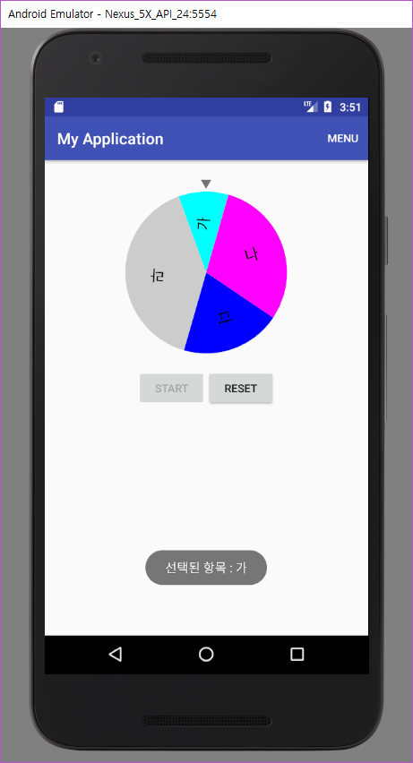
Toast
selected item
Handler
message
Thread Class

Slide 6
Roulette
MainActivity.java
final static int SELECTED = 1; final static int SELECTED_NON = 0; int lastAngle; …. Handler handler = new Handler(){ @Override public void handleMessage(Message msg) { super.handleMessage(msg); if(msg.what == SELECTED){ selectPop(); } } }; class SelectedThread extends Thread{ int threadDelay; public SelectedThread(int delay){ threadDelay = delay; } @Override public void run(){ try { sleep(threadDelay); Message.obtain(handler, SELECTED).sendToTarget(); } catch (InterruptedException e) { e.printStackTrace(); } super.run(); } } | public void selectPop(){ int currentAngle = 360- (lastAngle+90)%360; if(currentAngle<0) currentAngle = 360+currentAngle; float startAngle = 0; float collectAngle = 0; for(int i=0;i<circleView.label.length;i++){ collectAngle = startAngle+circleView.weight[i]*circleView.unitAngle; if(currentAngle>=startAngle && currentAngle<=collectAngle){ Toast.makeText(this, "선택된 항목 : "+circleView.label[i], Toast.LENGTH_LONG).show(); break; } else{ startAngle += circleView.weight[i]*circleView.unitAngle; } } }
가 : 0~36
나 : 36~108
다 : 144~72
라 : 216~144
currentAngle
90
360(lastAngle)

Slide 7
Roulette
MainActivity.java
@Override protected void onCreate(Bundle savedInstanceState) { … startButton.setOnClickListener(new View.OnClickListener() { @Override public void onClick(View v) { startButton.setEnabled(false); resetButton.setEnabled(true); Random rnd = new Random(); int angle = rnd.nextInt(360)*10; int delay = rnd.nextInt(500)*10; lastAngle = angle; circleView.animate().rotation(angle).setDuration(delay).start(); new SelectedThread(delay).start(); } });

Slide 8
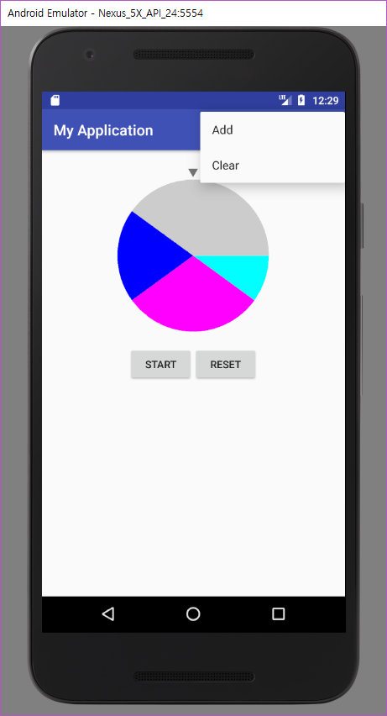
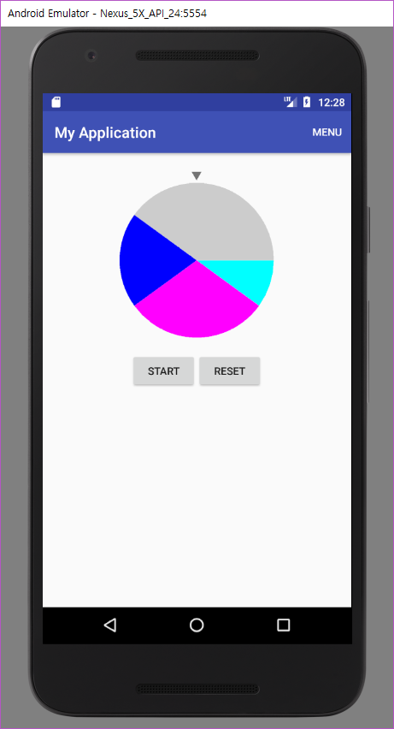

Slide 9
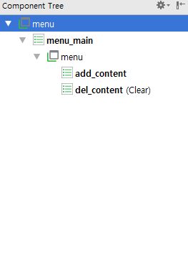
Roulette
main_menu.xml
<?xml version="1.0" encoding="utf-8"?> <menu xmlns:android="http://schemas.android.com/apk/res/android" xmlns:app="http://schemas.android.com/apk/res-auto"> <item android:id="@+id/menu_main" android:orderInCategory="0" android:title="menu" app:showAsAction="always"> <menu> <item android:id="@+id/add_content" android:title="Add" /> <item android:id="@+id/del_content" android:title="Clear" /> </menu> </item> </menu>

Slide 10
Roulette
MainActivity.java
@Override public boolean onCreateOptionsMenu(Menu menu){ getMenuInflater().inflate(R.menu.main_menu, menu); return true; }

